Slide 1



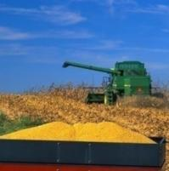

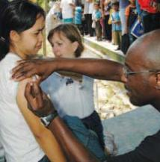

Science Mission Directorate
Earth Science Division
Earth Science Applications
Lawrence Friedl, Director
ESD Applied Sciences Program
Ecological Forecasting & Biodiversity Team Meeting • May 7-9, 2014

Slide 2
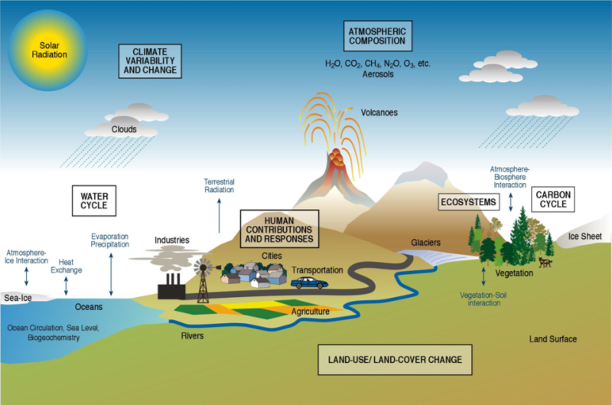


NASA Earth Science
Technology
Flight Missions
Research
Data Systems
Education
Applications
NASA Earth Science supports basic and applied research on the Earth system
and its processes.
Characterize, understand, and improve predictions of the Earth system to advance knowledge and benefit society.
|‌ 2
Notes:
A paradigm of variability, forcing, response, consequences and prediction.
A Space Program with a comprehensive, broad-based scientific research, technology, and applications element.
A scientific research, technology, and applications program with expertise and access to space.
------------
The NASA Earth Science Division supports basic and applied research on the Earth system and its processes.
Primary efforts are to characterize, understand, and improve predictions of the Earth system.
In parallel with research, NASA pursues innovative and practical uses of Earth science data and results to inform and support decisions of government, business, and civil society.

Slide 3
The mind may, as it appears to me, divide science into three parts. The first comprises the most theoretical principles, and those more abstract notions whose application is either unknown or very remote. The second is composed of those general truths which still belong to pure theory, but lead nevertheless by a straight and short road to
practical results. Methods of application and means of execution make up the third.
Each of these different portions of science may be separately cultivated, although reason and experience show that none of them can prosper long, if it be absolutely cut off from the other two.
Alexis DeTocqueville
Democracy in America, 1835

Slide 4
Earth Science and Applications
Basic Research
Applied Research
Applications
Notes:
The Program serves the following roles for ESD and SMD to help accomplish NASA’s responsibilities for the Nation:
Raise expectations for the use of NASA data and models in policy, management, and business and increase demand for NASA Earth science observations and research;
Advance Earth science research through enabling applications-oriented feedback on observation products, models, and algorithms from the applied community and end users;
Engage partners and decision-making organizations, inform them of NASA Earth science and represent them within ESD;
Promote applications to facilitate use of existing products and creation of new products;
Pioneer innovative methods for public and private organizations to apply Earth science observations to support the U.S. economy and government services;
Document socioeconomic benefits attributable to Earth science observations;
Promote the uses of NASA Earth science to inform US climate change policy assessments, business decisions and market activities, and monitoring progress.
The Applied Sciences Program serves three primary functions within ESD, SMD & NASA:
Science Advances and Technology Transfer
Applications projects can further scientific techniques (e.g., data assimilation, data fusion); interoperability standards drive technology; projects reduce perceived risk of its use and support transfer to private sector; operational use can provide testing and feedback on research algorithms and products; promote innovation; and generate applications knowledge and methodologies for the value of applications.
Societal Benefits
The Program serves the nation and society by helping partners improve their decision making – natural resource management, public safety and health, disasters, etc.
Outreach, Partnerships, and Marketing
Cultivate new partners to expand NASA’s reach and awareness. Projects facilitating partners’ sustained use of Earth science products helps induce demand for Earth science data and research. Applications of the products to policy and management issues shows the relevance of Earth science to key stakeholders. Promote and articulate socioeconomic benefits to highlight value.

Slide 5
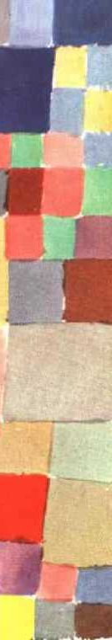
Public and private organizations routinely and seamlessly integrate Earth observations in their decisions and actions, and they demand additional observation types and Earth science knowledge.

Slide 6
Inform Decisions & Actions
Applied Sciences Program Approach to Integrated System Solutions
Predictions/ Forecasts
Value and
Benefits to citizens and society
Earth System Models
Partnership Area
Land, Atmosphere, Oceans, Cryosphere, Coupled Models
Model Products, Data Assimilation, Predictive Capabilities
High-Performance Computing, Communication, and Visualization
Decision Support Systems
Assessments
Scenario Tools
Policy Decisions
Data
Standards and Interoperability
Management Decisions
Earth Observatories & Measurements
Analysis to support decision-making processes & actions
Satellite, Airborne, Ground, In-situ
Missions, Sensors, Data Products
Observations
Inputs
Outputs
Outcomes
Impacts
NASA and Partners
Partners with Decision Support Systems
|‌ 6

Slide 7
Socioeconomic Impacts: A Primer
Purpose:
Inform the Earth observations community and project teams about the language, key principles, techniques, and applications of socioeconomic impact analyses.
Released March 2013
|‌ 7

Slide 8
Applications Heritage
Studies of the lineage and heritage of applications in scientific research, mission, data systems, technology backgrounds, decision support tools, partnerships, etc.
Studies support understanding of effective approaches to bridge from research & development to applications and sustained uses. Studies examine pathways from scientific and technical achievements that led to and enabled applications.
Heritage in Science & Technology
Global Fire Information Management System (GFIMS)
Heritage study of this
application is developed and
is in final draft. Considering publication options.
Heritage aspects include:
Technology: Sensors, Satellites, and Algorithms
Field Campaigns
Data Access and Latency
Conferences, Collaborations, and Partnerships
Decision Support Systems
|‌ 8
Notes:
Scientific Heritage
A study of projects in each Applications Areas on the scientific heritage and research, mission, data systems, technology backgrounds. Supports understanding of effective approaches to bridge from research & development to applications and sustained uses. Study will examine pathways from scientific and technical achievements that led to and enabled an application.

Slide 9
Users, Behaviors, Preferences
Where and how do people get their data and information?
What are demographics and user characteristics?
Notes:
Report on the Demographic breakdown of a Website or Industry by Age, State, or Gender.
Rank websites by Age, State, or Gender.

Slide 10
perceptions
attitudes
satisfaction factors
technographics
aversion to new information sources
familiarity with Earth observations
user traits
existing value chains
consumer information
disposition to technology
expected level of service and support
psychographics
lifestyle
trusted sources
preferences
Notes:
“User characterization” is meant to delineate and portray the user base (active and potential). Characterizations would examine and describe key aspects of generalized user groups and user types as a way to segment sub-groups of user with specific motivations.
Characterizations would likely capture:
- key demographics, traits, psychographics, lifestyle, technographic, etc.
- associated consumer information, such as preferences, perceptions, attitudes, satisfaction factors, etc.
- familiarity with Earth observations, aversion to new information sources, disposition to technology, etc.

Slide 11
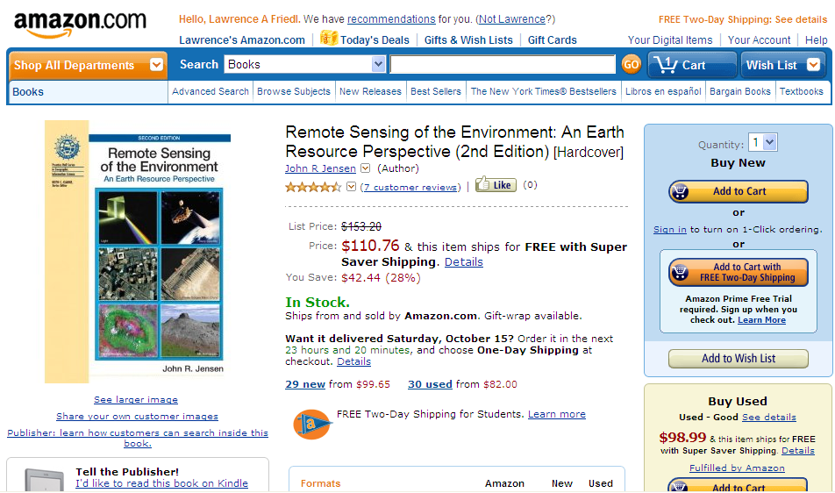
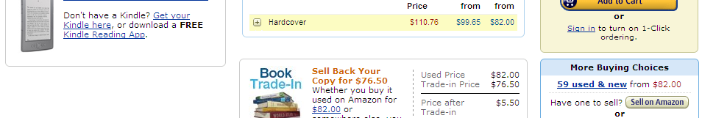
Notes:
Amazon.com represent some of the web-based customer service standards that customers have come to expect.
Issue: Are we following commonly-expected customer-service standards for web-based products and services?

Slide 12
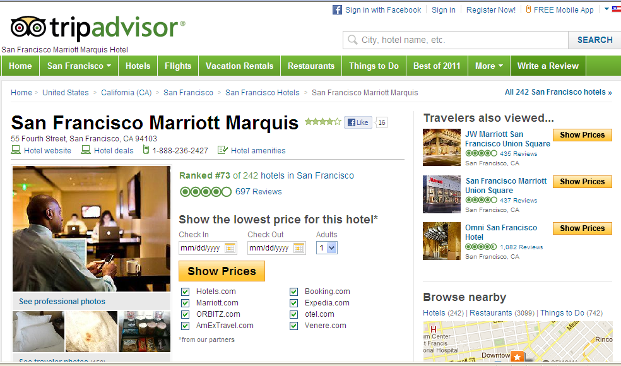
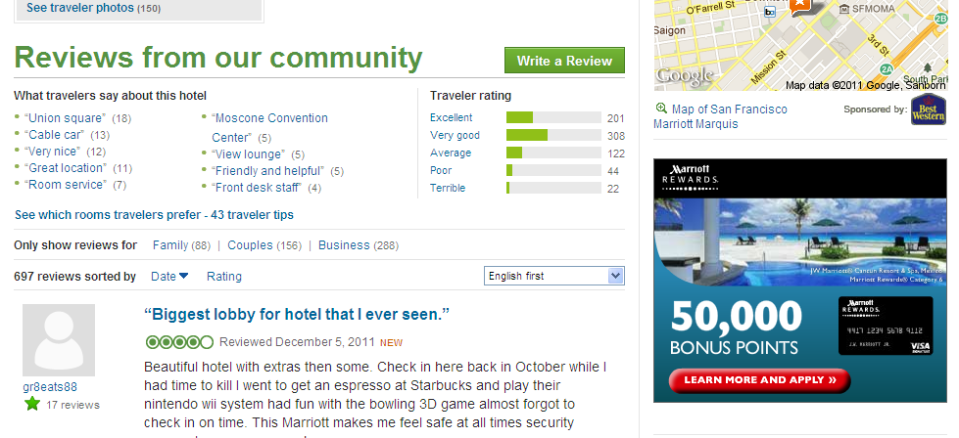

Slide 13

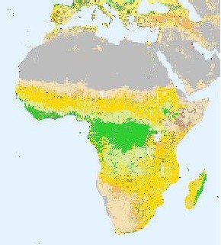
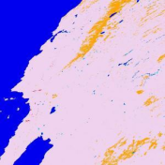
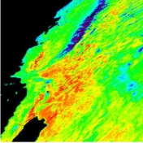
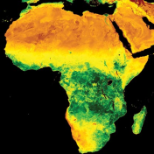
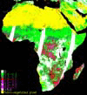
earth.orb
Hello Lawrence Friedl. We have recommendations for you.
Lawrence’s earth.orb | Today’s Specials | Wish List
Search
Search all SBAs
GO
Cart
Land Cover Type Yearly L3 Global 1km SIN Grid
Terra-MODIS
 (13,769 user reviews)
- - - - - - - - - - - - - - - - - - - - - - - - - - - - - - - - - - -- - - - - - -- - - - - - -- - - - - - -
Level 3.
Ships from Land Processes DAAC
Customers Who Accessed This Item Also Accessed
  Burned Area Emissivity (LST) Vegetation (NDVI) Leaf Area Index (FPAR)
     
Editorial Reviews
MODIS Science Team
The MODIS Land Cover Type product contains multiple classification schemes, which describe land cover properties derived from observations spanning a year’s input of Terra data. The primary land cover scheme identifies 17 land cover classes defined by the International Geosphere Biosphere

Slide 14
Programme (IGBP), which includes 11 natural vegetation classes, 3 developed and mosaicked land classes, and three non-vegetated land classes.
The MODIS Terra Land Cover Type Yearly L3 Global 1 km SIN Grid product incorporates five different land cover classification schemes, derived through a supervised decision-tree classification method.
See all Editorial Reviews
Product Details
  Product code: MOD12Q1
  Platform: Terra
  Raster Type: Tile
  Resolution: 1000m
  Temporal Granularity: Annual
  Earth Science Best Sellers Rank: #142
Customer Reviews
  Average Customer Review:  (278 customer reviews)
  Most Helpful Customer Reviews
  78 of 81 people found the following review helpful:
  Latest product is based on MODIS v.5; found that the urban classification is underrepresented but otherwise a great product.
› See all 278 customer reviews...

Slide 15
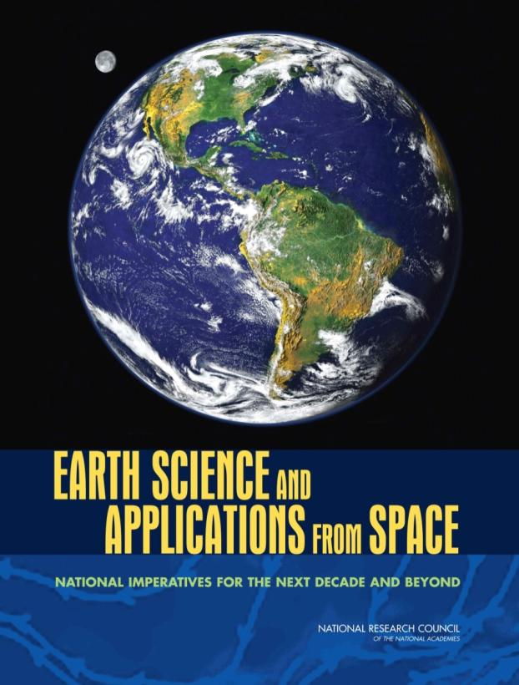
Earth Science & Applications from Space
The national strategy outlined here has as its overarching objective a program of scientific discovery and development of applications that will enhance economic competitiveness, protect life and property, and assist in the stewardship of the planet for this and future generations.
Earth Science Decadal Survey
2007
|‌ 15

Slide 16
Missions & Applications
Applications in Mission Life-cycle
Significant efforts for applications-oriented users to engage throughout the satellite mission lifecycle, especially planning, formulation, and development phases. Examples include:
Community Workshops
Early Adopters
Mission Applications Plans
Applications Traceability Matrices
Webinars
Tutorials
|‌ 16

Slide 17





















Earth Science Missions – Early Adopters
Early Adopters: New with SMAP
Purpose is to conduct pre-launch applications research to accelerate use of data after launch.
Organizations with clearly-defined needs for SMAP-like data products evaluate & demonstrate the utility of SMAP data for their application and decision making.
Early Adopters:
Use data products prior to launch (simulated data and cal/val data from field campaigns)
Provide feedback on products and formats
to increase applications value of mission
Streamline and accelerate use of data soon after launch and check-out
Supply own resources to do these activities
35+ organizations are currently EAs from public & private-sector, domestic & foreign
** ICESat-2 started Early Adopters in 2013 **
|‌ 17
Notes:
As part of the plan, SMAP has an Early Adopters program for organizations that have clearly defined needs for SMAP-like data products and will evaluate and demonstrate the utility of SMAP data for their particular system or model. EAs are given access to the SMAP simulated data (e.g., reformatted SMOS products) as well as cal/val data from all field campaigns.
SMAP created an Early Adopters program for organizations that have clearly defined uses for SMAP-like data products. Early Adopters receive simulated SMAP data products to evaluate and demonstrate the utility of SMAP for their particular decision-making activities. Using their own resources, Early Adopters provide feedback on data products to increase SMAP’s application value and streamline uses of SMAP data soon after launch. SMAP selected seven organizations in 2011 as the inaugural Early Adopters. Eleven organizations joined in 2012, and 2 more to date in 2013. Early Adopters include organizations like USGS, Willis-Global Analytics, ECMWF, Environment Canada, and the U.S. Department of Agriculture’s Foreign Agricultural Service.
ICESat-2 will use Early Adopters also.

Slide 18
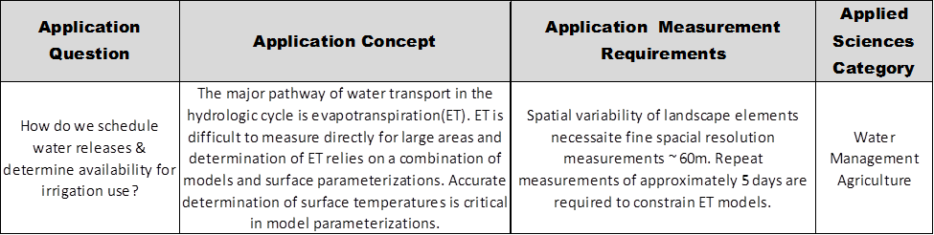
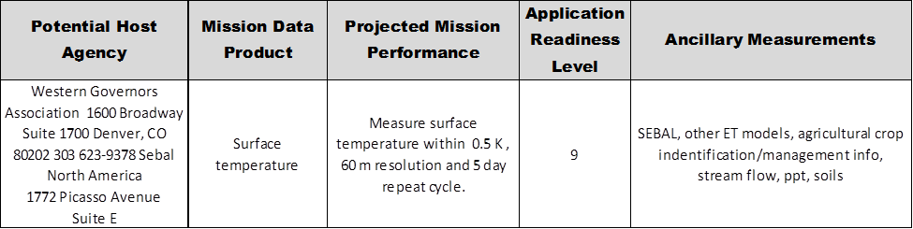
HyspIRI: Applications Traceability Matrix
PACE
The following is an example row from the
HypspIRI Applications Traceability Matrix
|‌ 18
Notes:
This slide is an example row from the HypspIRI Applications Traceability Matrix

Slide 19
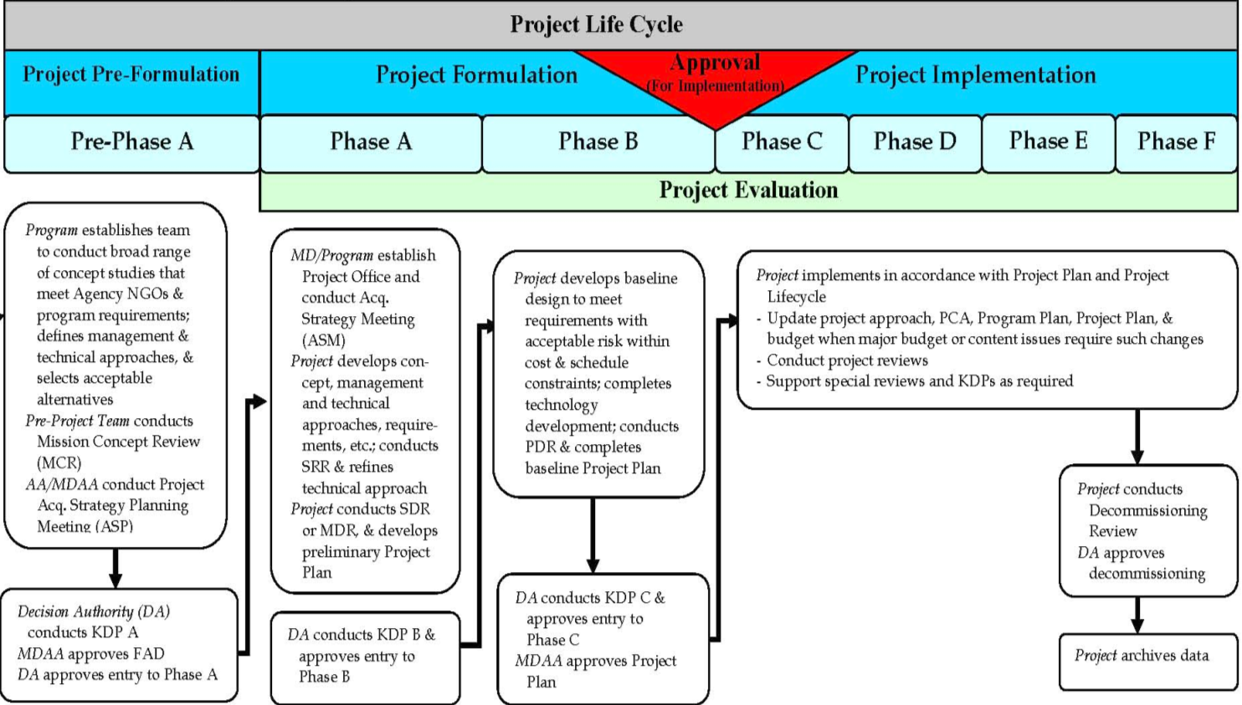
NASA Flight Project Life Cycle
Mission Phase Durations: Mission development (A – D) duration may be 5 to 8 years
2–n years
½–1½ years
1–2 years
1–3 years
1–1½ yrs
3–10+ years

Slide 20
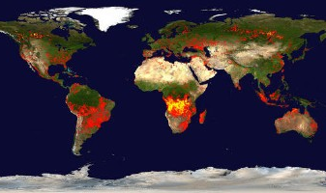
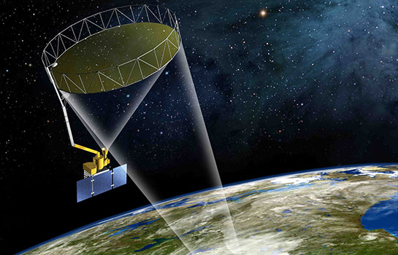
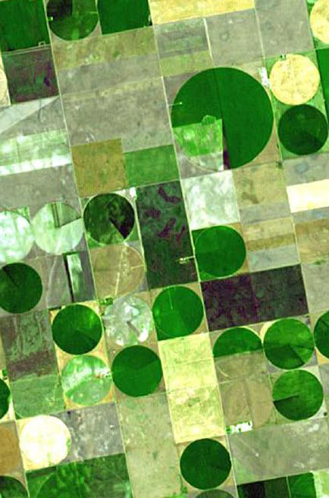
NASA Earth Science
Applied Sciences Program
NASA Headquarters
Washington, DC
1.202.358.7200
http://AppliedSciences.NASA.gov

Slide 21
Back-up Materials
http://AppliedSciences.NASA.gov

Slide 22

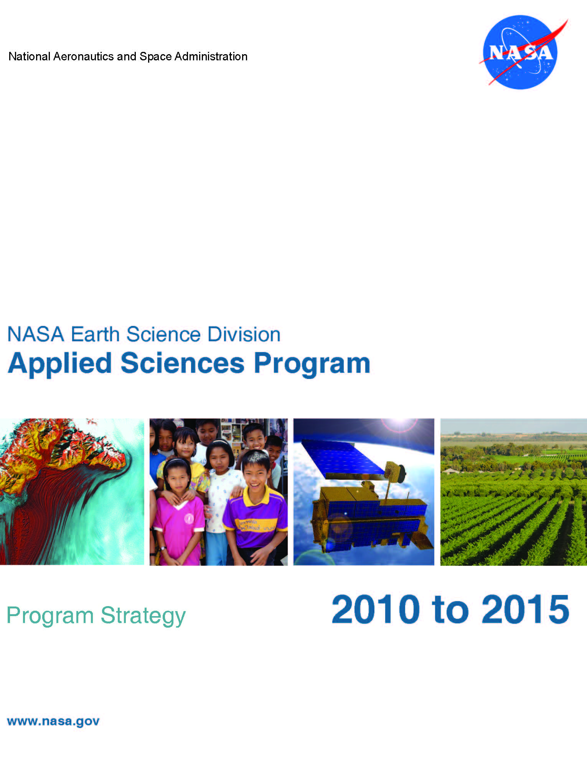
Lines of Business
Discovering and demonstrating innovative and practical uses of
Earth observations in organizations’ policy, business, and
management decisions.
http://AppliedSciences.NASA.gov
Applications
Prove-out, develop, and transition applications ideas
for sustained uses of Earth obs. in decision making.
Capacity Building
Build skills and capabilities in US and developing countries to access Earth observations to benefit society.
Mission Planning
Identify applications early in mission lifecycle and integrate end-user needs in mission design and development.
|‌ 22

Slide 23
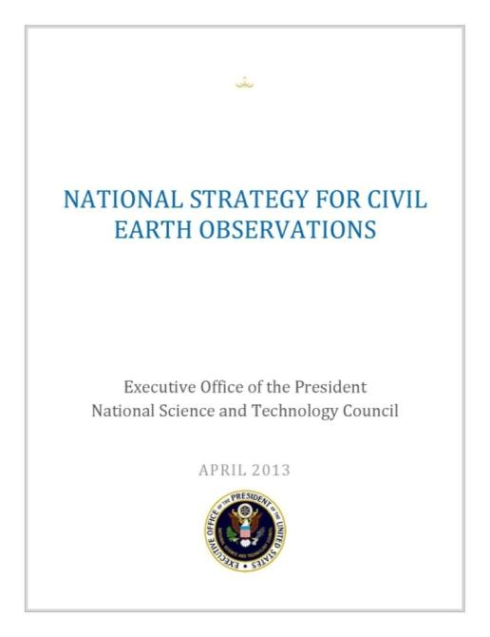
Interagency
http://www.whitehouse.gov/blog/2013/04/19/taking-pulse-our-planet-new-strategy-earth-observations
Supports efforts to organize existing
Earth-observation systems and to coordinate plans for future projects.
Provides an evidence-based framework for routine assessment, prioritization,
and planning across all Federal agencies engaged in Earth observations.
In development:
National Plan for Civil Earth Observations, 2014-2024
Addresses sustained and experimental observations, priority observations, balanced portfolio approach, and guidance on implementation.
Plan is organized by the interagency
U.S. Group on Earth Observations (USGEO), a Subcommittee within NSTC CENRS
National Civil Earth Observations Strategy
Released 4/19/2013
|‌ 23

Slide 24
Applications & Capacity Building
The Applied Sciences Program funds projects that enable uses of NASA Earth science data in organizations’ policy, business, and management decisions.
Applications Areas
The program focuses on economic, health, resource management, and other themes to discover and demonstrate applications targeted at integrating Earth observations in specific decision-making activities. Projects with public and private organizations.
Applications Projects
Feasibility Studies
Applied Research Teams
Mission Planning Support
Capacity Building
The program sponsors specific activities to build skills, users, and capabilities in the US and developing countries on how to access and apply environmental satellite data to benefit society.
SERVIR
DEVELOP & Workforce development
Gulf of Mexico Initiative
Training Modules
|‌ 24
Notes:
Applications Areas: Proving-Out Applications; Demonstration of Applications Ideas, Realization of Socioeconomic Benefits, and Transitions
Capacity Building: Building Customers; Creating Opportunities for New Users & Organizations to be Aware and Able to Use Earth Science

Slide 25
Performance
Applications Readiness Levels (ARL)
9. Approved, Operational Deployment
and Use in Decision Making
8. Application Completed and Qualified
7. Application Prototype in Partners’
Decision Making
6. Demonstrate in Relevant
Environment
5. Validation in Relevant Environment
4. Initial Integration and Verification
3. Proof of Application Concept
2. Application Concept
1. Basic Research
ARL 9
–
ARL 8
–
ARL 7
–
ARL 6
–
ARL 5
–
ARL 4
–
ARL 3
–
ARL 2
–
ARL 1
Partner Demonstration and Transition
Development, Test, and Validation
Discovery and Feasibility
|‌ 25

Slide 26
Applications Readiness Level
Applications Readiness Level (ARL)
Nine-stage metric to track the maturity of applications projects – from initial idea, through development, to the transition to operational use.
ARL as a tool:
Communication Tool to convey expected advancement to PIs & project teams.
Analysis Tool to assess progress of a project or state of entire project portfolio.
Reporting Tool for performance goals.
Diagnostic Tool to identify where projects tend to break down in development.
ARL 9
–
ARL 8
–
ARL 7
–
ARL 6
–
ARL 5
–
ARL 4
–
ARL 3
–
ARL 2
–
ARL 1
ARL 7-9: Partner Demonstration and Transition
ARL 4-6: Development, Test, and Validation
ARL 1-3:
Discovery and Feasibility
|‌ 26
Notes:
SMD/ESD introduced and refined a nine-stage Applications Readiness Level metric to track the maturity of applications projects—from the initial idea, through its stages of development, to its transition to operational use. The Program assesses the projects’ ARLs on a routine basis throughout the year. On the ARL scale, ARL 1 represents basic research and ARL 9 represents operational deployment and use in decision making. ARLs 1-3 generally focus on discovery, feasibility, and proof of concept. ARLs 4-6 focus on applications development, testing, and validation. And, ARLs 7-9 focus on application demonstration and transition into operations.
The ARL index provides a scale for Applied Sciences program managers to convey the expected advancement of applications projects and to assess the actual progress of a project. Project teams can use the ARL to establish and articulate key project milestones.

Slide 27
Comments from peers
Suggestions
Rating system
Message boards
Personal tailoring
Feedback at the point of experience
One-touch efforts
and, of course, free shipping on orders over $25
Notes:
What are Customer Service Standards on the Internet?

Slide 28
Key Questions to be Addressed in Pre-Phase A
Should be resolved ~ 12 months prior to KDP A
What science MUST this mission achieve?
  What specific measurements?
  To what accuracy?
  What are the required data products?
What mission parameters can achieve the science?
  What orbit (inclination/altitude)?
  Which instruments?
  What is the baseline mission duration?
How can NASA achieve these measurements?
  Are there other missions required/desired to achieve the science?
  Who can NASA partner with to achieve this mission?
Should be resolved ~ 6 months prior to KDP A

Slide 29

topics
Intellectual context and what i/we are wrestling with
Vision
Customer oriented view of applications
Though can lead to new research questions
Rewards within the Applied research
Natural-social sicence intereactions: can go applied but not ncessarily. Again, new research questions
Research quetoisn from users
Way to sell the research
Induced demand
Heritage reports
Amazon.com example
User demogratics and technographics
Cross-disciplinary
Tie back to Decadal Survey
Bring in EO Plan
|‌ 29
Notes:
A paradigm of variability, forcing, response, consequences and prediction.
A Space Program with a comprehensive, broad-based scientific research, technology, and applications element.
A scientific research, technology, and applications program with expertise and access to space.

Slide 30
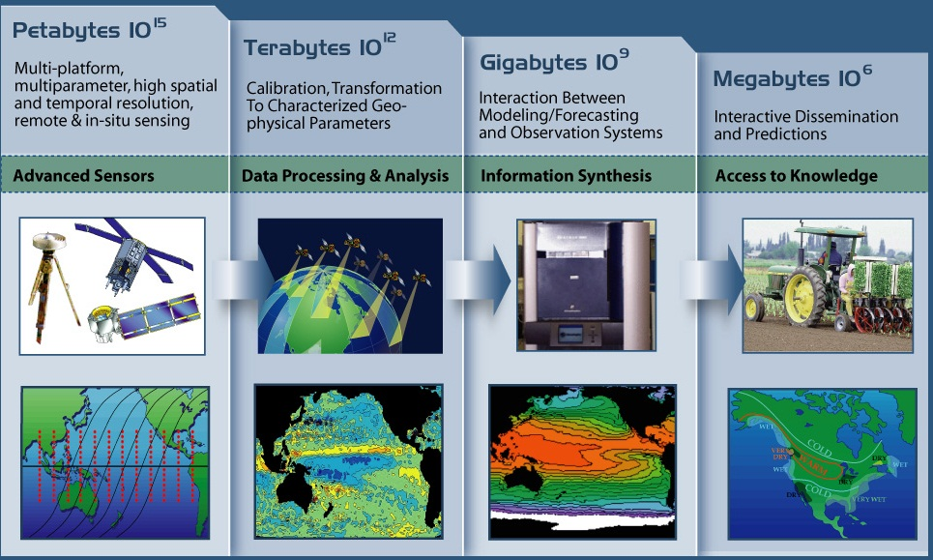
Observations to Knowledge Products
“from photons to electrons to neurons”
Notes:
Trends-Process-Models
Understanding environment in many ways.
- able to detect subtle trends in amongst the variability
- detect and ATTRIBUTE the trend
- process: Attributes the reasoning
- Models are the codification of the knowledge (not for modeling sake); it’s WHAT WE KNOW
To do the hard challenges, we need perspectives from multiple approaches

Slide 31
Notional Mission Timeline
NOTE: The time for each phase is considered nominal - could be accomplished earlier

